Slide 1
Jump Rope For Heart
Animation by Tyler Morgan
Notes:
WELCOME TO JUMP ROPE FOR HEART! Good morning/afternoon (school name)! My name is (your name) and I’m here from Heart & Stroke where we work to keep everyone’s heart and brain healthy. I’m so excited to be here for your school’s Jump Rope for Heart kick-off! If New school: How many of you have heard of Jump Rope for Heart?
If Returning school: How many of you remember participating in Jump Rope for Heart last year?
For those of you who have heard of Jump, or remember participating before, you probably know that there’s a lot of this: [Click to animate] Jumping rope with your friends and your classmates outside or in the gym on event day! Coming together to practice skipping skills and other simple exercises is always a blast.

Slide 2
By fundraising for Jump Rope for Heart, you’re collecting donations that fund critical research that’s saving lives, preventing heart disease and stroke, and supporting survivors and their families.
Here are just some of the ways the dollars you raise help:
● $31 million supported approximately 1,000 top medical researchers across Canada.
● 8,000 life-saving automated external defibrillators (AEDs) were placed in communities across Canada.
● eTools (such as the Heart & Stroke Risk Assessment) were developed to empower all Canadians to lead healthier lives.
● We partnered to create Stop Marketing to Kids — a campaign protecting kids from unhealthy food and beverage advertising.
Why fundraise?

Slide 3
1)
Protect your heart and brain health
Why we Jump
2)
Help Heart & Stroke save lives
3)
Have more fun at school
Notes:
WHY WE JUMP
Now you know why we fundraise for Jump! To protect heart and brain health, to help Heart & Stroke save lives, and to have more fun at school by fundraising towards your goal! But how do we fundraise for Jump?

Slide 4
jumpropeforheart.ca
How to fundraise online
1
Ask your parent or guardian for help
Go to jumpropeforheart.ca
Click
2
3
JOIN YOUR SCHOOL
Notes:
The best and easiest way to start saving lives and raising funds for Jump is to go online. With your parent or guardian’s permission, you can visit our website: jumpropeforheart.ca. Here you can click ‘Join Your School’ to make your own fundraising page and start emailing family and friends to ask for donations.
Some of the coolest reasons to fundraise online are:
You can set-up a personal page by adding a picture of you and a short story about why you’re fundraising
You can ask family and friends who live far away for a donation by sending them an email with your personal page
You can earn virtual badges for fundraising online and for just sending emails
Did you know, many students raise twice as much when they fundraise online? That’s why raising collecting donations online can launch your school towards your goal in a big way!

Slide 5
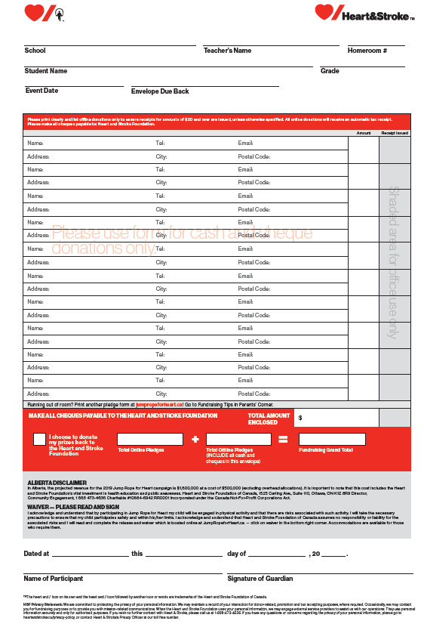
Put money and cheque donations inside the envelope
Write the name and address of people who donate on the back.
Fundraise with an envelope
Fundraise from people you know and trust.
Notes:
FUNDRAISE WITH AN ENVELOPE You can also fundraise for Jump using the envelopes that your teacher will hand out later today. If your family or friends hand you money or a cheque, put it inside the envelope and ask them to write their name and where they live on the back we can send them a receipt.
Remember to only fundraise from people that you know and trust. Don’t go door-to-door unless a parent or guardian is with you.

Slide 6
Last year we raised just over $5000!
This year, if we raise:
$5000 – Mrs. Friel will die her hair unicorn colours!
$6000 – PJ day for staff and students at Townsview School – Mrs. Thorne will wear her PJs too!
School-based incentives

Slide 7
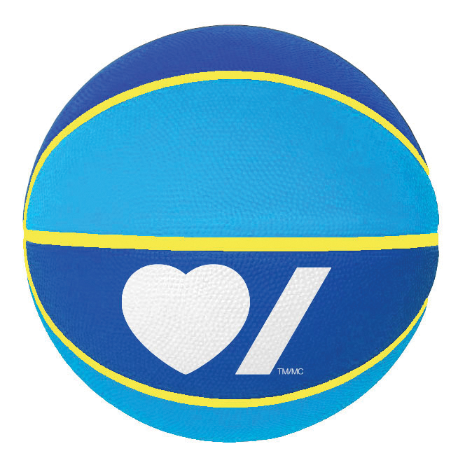
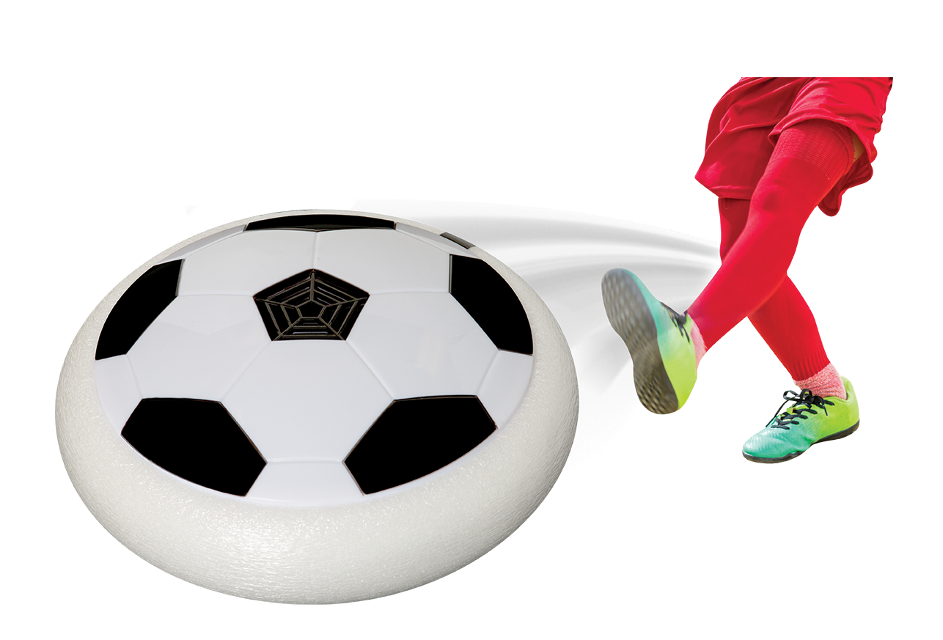
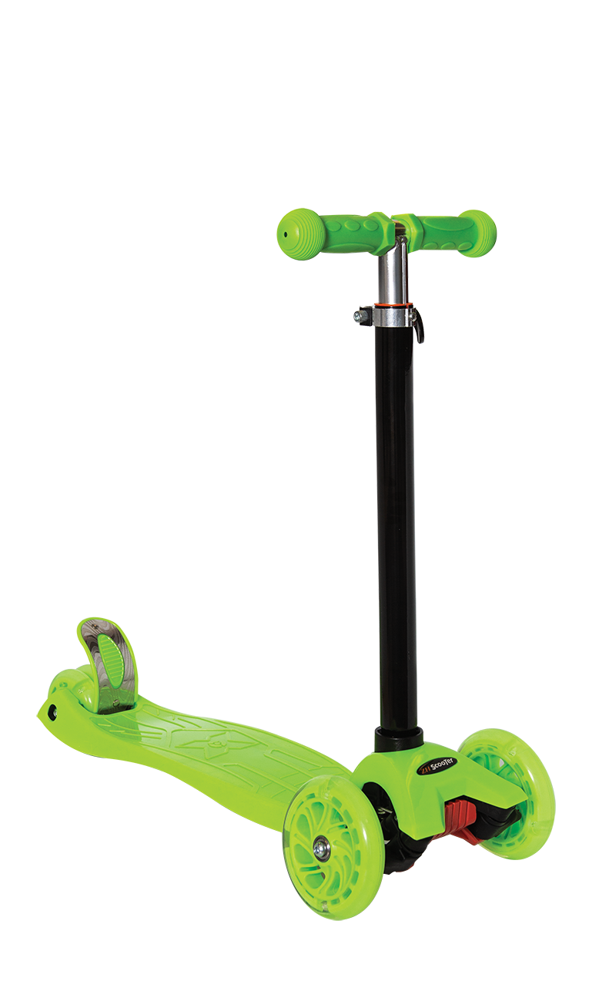
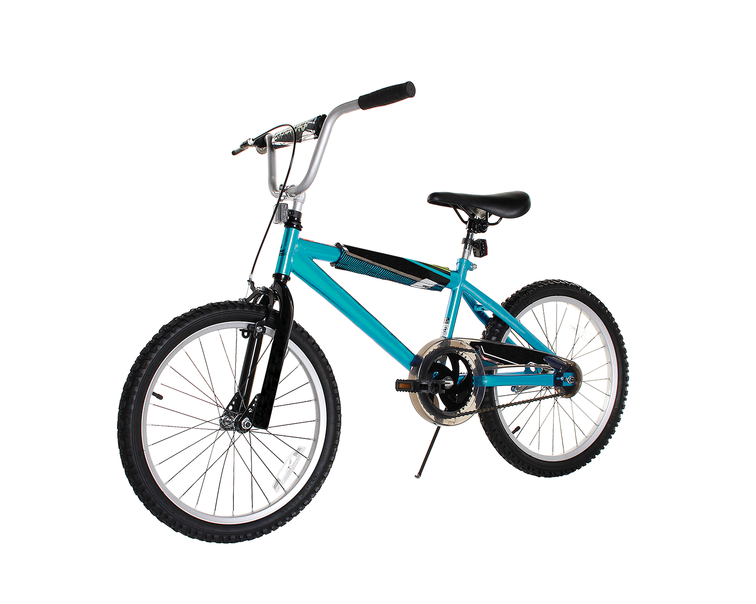
Raise $25:
Mini basketball
Raise $75:
Hover
air soccer
Thank You Prizes
Raise $250:
Light-up scooter
Raise $500:
V-Tech Action Cam
Raise $1000:
Bike
Notes:
THANK YOU PRIZES
Not only is fundraising a great way to help others, you earn awesome prizes as a Thank You from us that will keep you active.
All of the Thank You prizes in this year’s line-up will keep your heart beating faster well after Jump Rope for Heart is over. Level 1: Mini basketball $25+

Slide 8
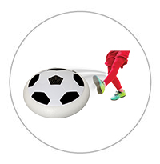
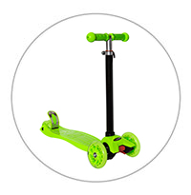
jumpropeforheart.ca
$5 =
Online bonus prizes
$150 =
$350 =
Notes:
ONLINE BONUS PRIZES Another good reason to fundraise online is earning more prizes! In fact, you can earn up to 3 online bonus prizes by fundraising at www.jumpropeforheart.ca.
The online bonus prizes include:
A skipping rope when you earn $5 online
A $15 gift card when you raise $150 online
A $25 gift card when you raise $350 online

Slide 9
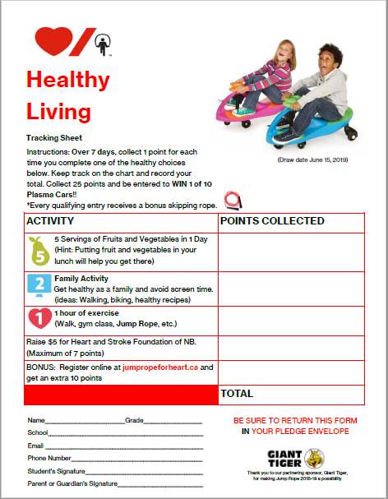
Healthy Living
Contest
Notes:
Now you are going to take everything you learned today and tell your family all about it. This year I have added a fun contest to keep everyone healthy. Each of you collect points by being active and eating fruits and vegetables. Even if you don’t fundraise, return this Healthy Living Sheet in your envelope to your teacher. Your name will be entered into a draw to win a plasma car.

Slide 10
Let’s help Heart & Stroke save lives!
Thanks for jumping!
Let’s get those hearts pumping!
Let’s be active at home and school!
Notes:
THANKS FOR JUMPING!
In the lead up to your Jump Event, remember to do these 3 things:
Protect your heart and brain health by practicing your skipping skills and the EASY healthy habits. Make sure you’re physically active for at least 60 minutes a day!
Help Heart & Stroke save lives by sharing the FAST signs of stroke with your family and your friends
Have more fun at school by fundraising and launching your school toward your goal! When you visit family and friends, you can say: “I’m protecting my heart and brain and helping Heart & Stroke save lives by raising money for Jump Rope for Heart. Would you like to support me?”
Thank you for jumping everyone. Don’t forget to visit www.jumpropeforheart.ca and get started today!

Slide 11
Remember to tell your family all about….
Animation by Tyler Morgan
Notes:
Remember to tell your family all about:
Today we learned about our hearts, our brains, 5210, and FAST (signs of a stroke) and the Healthy Tracking Sheet!!!
Thank you everyone!

